Slide 1
OMICSPATH-OMICSDI and Pathways Integration
Gaurhari Dass
OMICSDI Team

Slide 2
What is OmicsDI?

Slide 3
What is OmicsDI?
Search Capabilities across multiple Omics Data Types and Distributed databases.
Recommendation system based on similarity metrics between datasets.
Data Reuse and Citation: Giving Value to the Data.

Slide 4
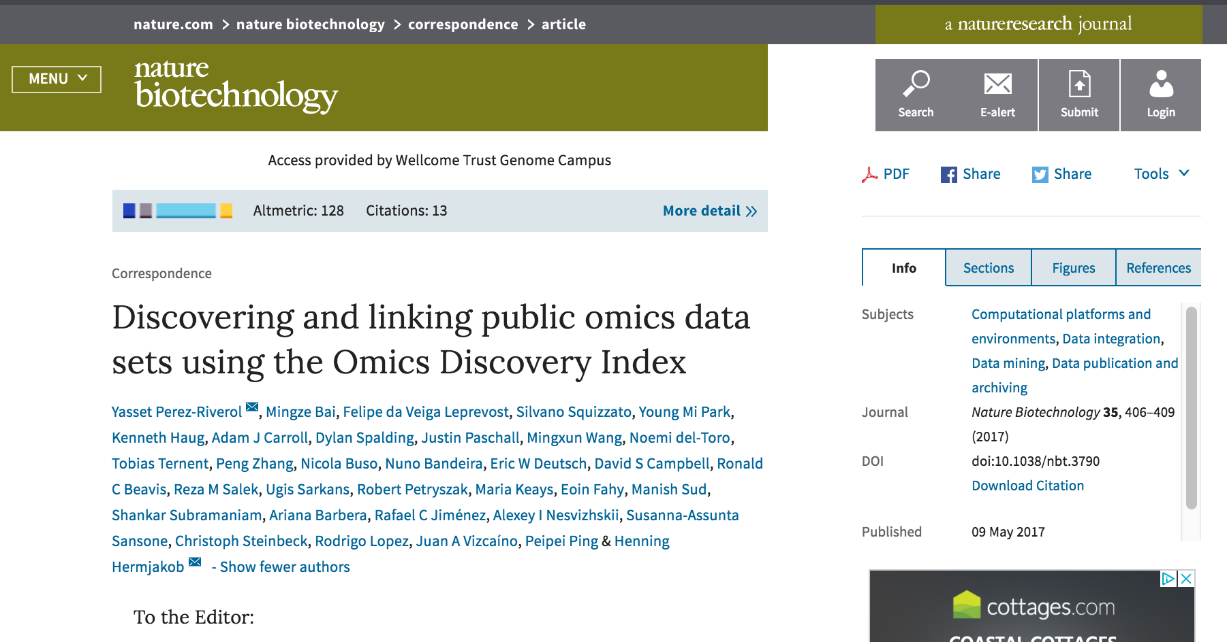
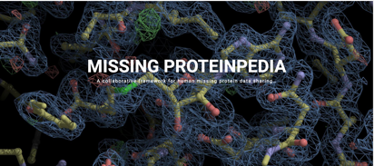

Slide 5









Dataset Statistics
PRIDE
PeptideAtlas
2365 datasets
June 2017 – December 2018
JPOST
4617 datasets
ArrayExpress
GPMDB
95 datasets
367 datasets
70764 datasets
EGA
MetabolomeExpress
PaxDB
58 datasets
493 datasets
5950 datasets
Expression Atlas
LINCS
GNPS
2913 datasets
662 datasets
350 datasets
Metaboligths
Massive
BioModels
326 datasets
1260 datasets
8418 datasets
Metabolomics Workbench
619 datasets

Slide 6
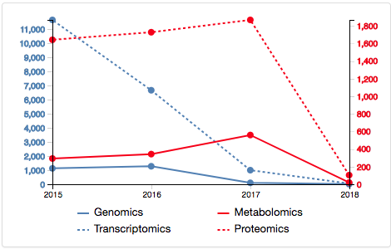
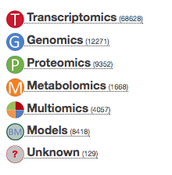
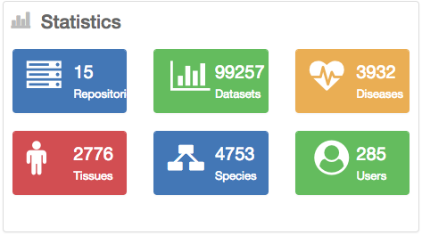
Data statistics

Slide 7
New features (September 2017 – November 2018)
Data Reuse and Citation.
Get Credit for your data: Data Claiming.
New Metrics for Quantification of data.

Slide 8
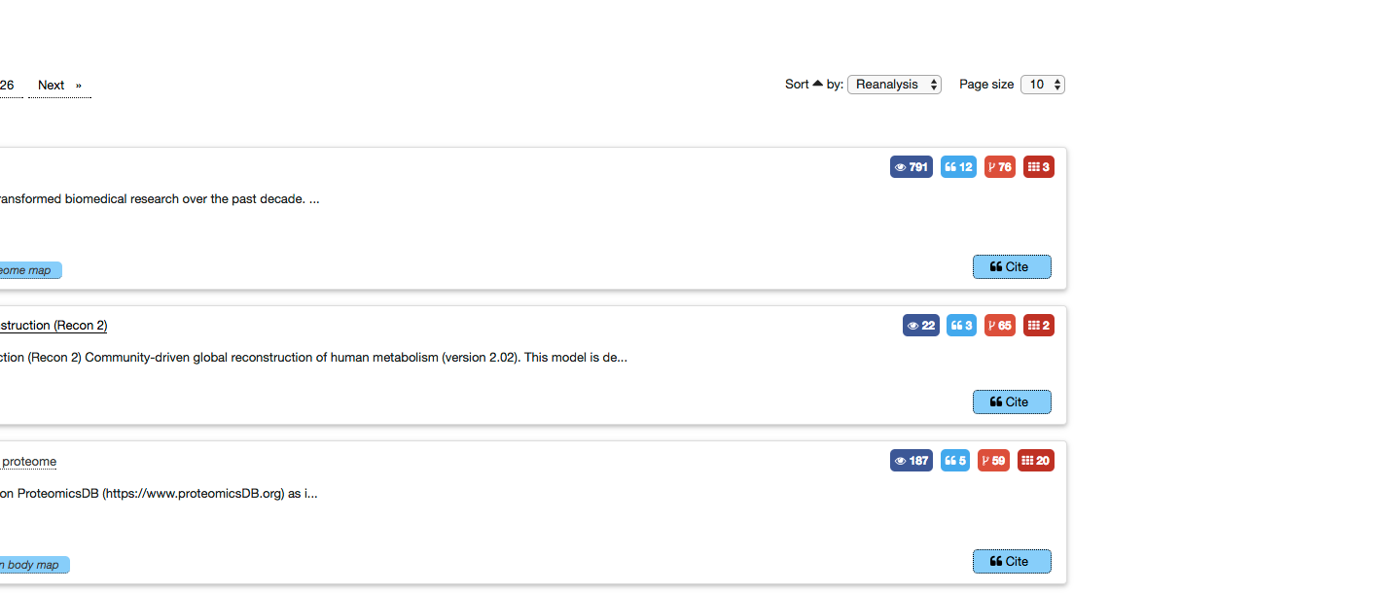
Data Value: Measuring the Value of the data
Number of Reanalysis by other datasets.
Number of reanalysis
Reanalysis a direct reference by another dataset to a dataset. For example, the reuse of a biomodel by another model. This information is provided by the databases.

Slide 9

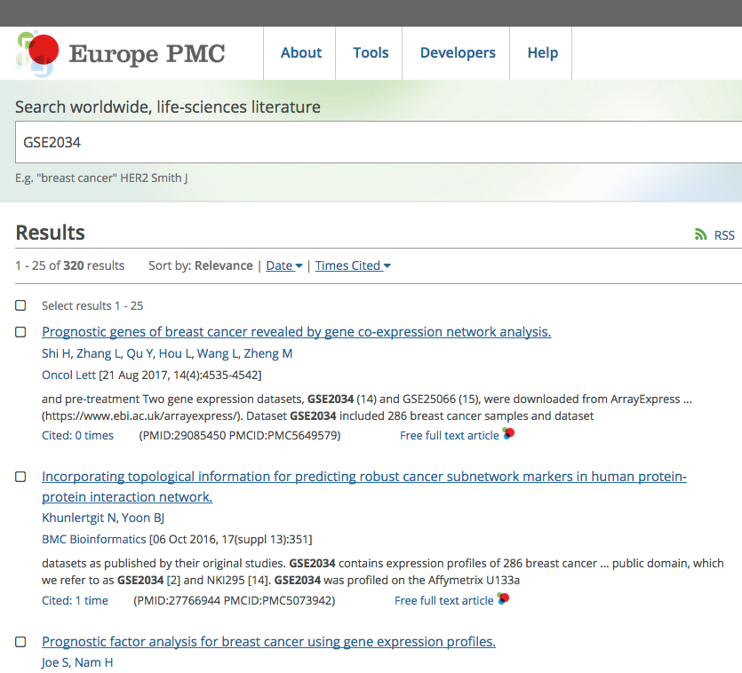
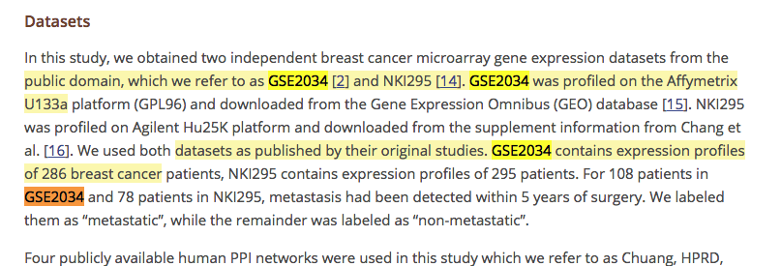
Data Value: Measuring the Value of the data
Number of Direct Citations in Publication.
Citations is the number publications that directly cite the dataset accession.

Slide 10
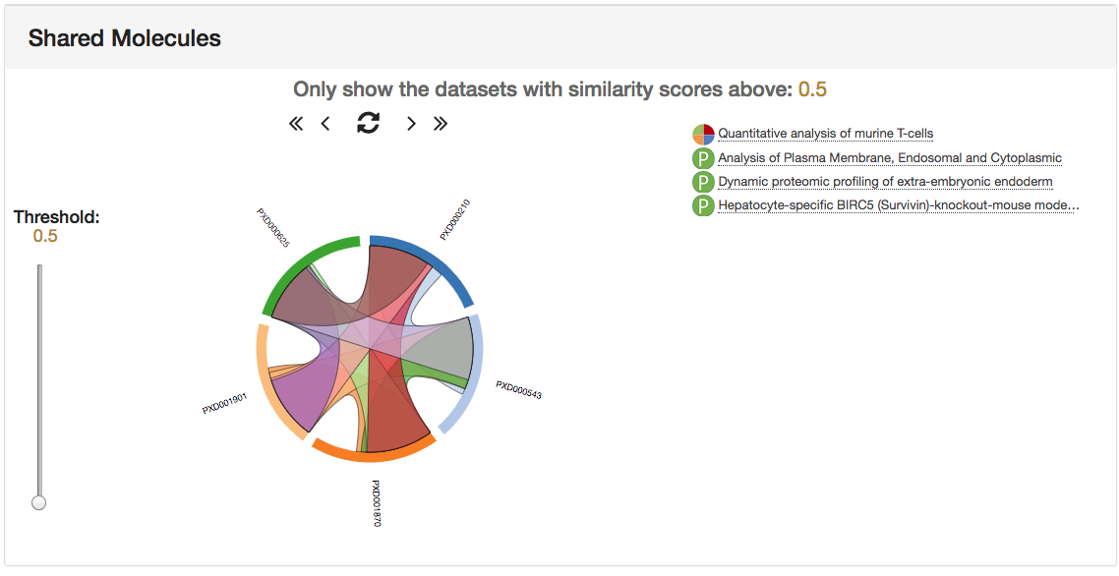
Data Value: Measuring the Value of the data
Number of Biological Entities in other EBI resources.
Uniprot
3000 proteins
Intact
300 interactions
PRIDE Dataset
Reactome
50 pathways
Connections, number of biological entities in other databases/resources in EBI that are supported by the dataset.

Slide 11
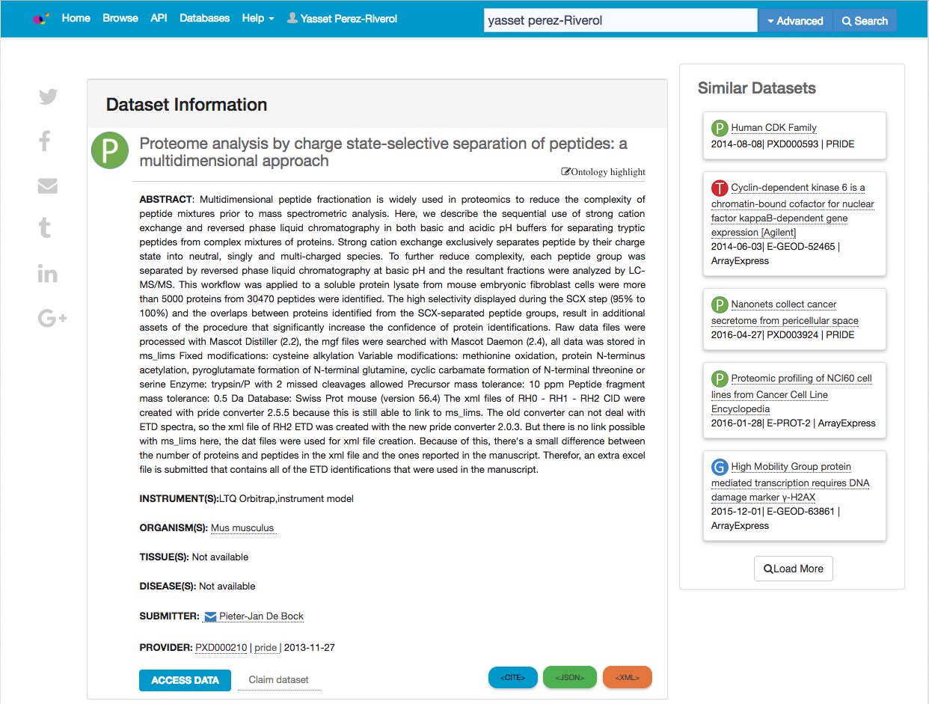
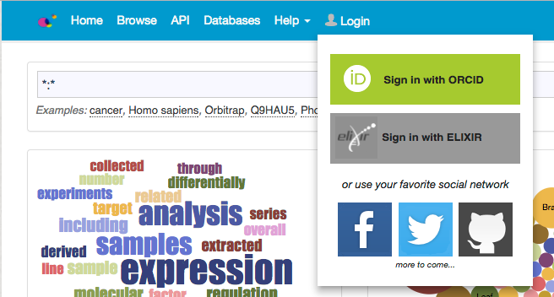
Data Credit: claiming component
Claiming independent datasets
Login using ORCID or ELIXIR AAI
Claim your dataset, that will appear automatically in your profile.
Sync with ORCID
~808 datasets claimed
~200 datasets sync to ORCID
287 users

Slide 12
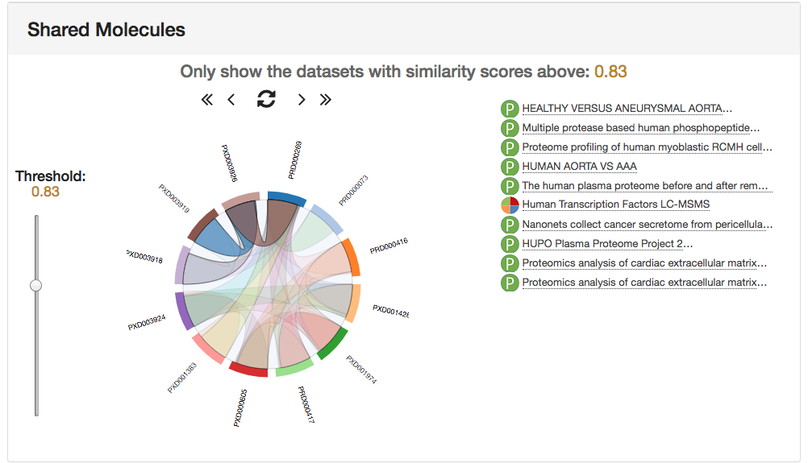
Similar Datasets

Slide 13
Pathways

Slide 14
Conclusions and Remarks
OmicsDI provides a unique resource for omics dataset searching.
Metadata, biological entities or publication enables to find similar datasets on public repositories.
Reuse and Citation is now possible using OmicsDI.

Slide 15
THANK YOU

